Slide 1

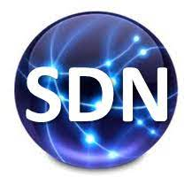




PDS
Computer Vision
Wireshark on GNS3
MPLS VPN &
Border Gateway protocol (BGP)
BGP message with Wireshark on GNS3
@ P. Siagian
Border Gateway protocol (BGP)
https://github.com/siagianp
https://www.youtube.com/@AmelOline/videos
https://github.com/amelcharolinesgn2/IoT_simulator-mqtt-NodeRed
https://github.com/amelcharolinesgn2/Cloud-Infrastructures
https://github.com/amelcharolinesgn2/ClouD-Infrastructure-SISKA-2025
https://github.com/amelcharolinesgn2/Gyroscope-Sensor-Data-Accelerometer
Notes:
https://www.gns3.com/marketplace/labs
https://github.com/Rakibul73/Cisco_Network_Routing_Switching
https://github.com/Rakibul73/Cisco_Network_Routing_Switching/tree/main/Problem_Lab_BGP
https://networklessons.com/labs/bgp-professional-lab-1#BGP_Prefer_eBGP_over_iBGP
https://github.com/Rakibul73/whiteboard-app

Slide 2
Wireshark on GNS3 Step-by-Step Setup: Wireshark + GNS3 Integration
https://gns3.com/step-by-step-setup-wireshark-gns3-integration
1. Install GNS3 and Wireshark
Install GNS3 All-in-One for easy setup.
During Wireshark installation, make sure to check the option to install Npcap (required for capturing packets).
2. Configure GNS3 to Use Wireshark
Open GNS3 → Edit → Preferences
A. Configure Wireshark Path
Go to: Edit → Preferences → Packet Capture
Under "Path to Wireshark executable", click "Browse"
Navigate to your Wireshark installation folder and select:
On Windows: wireshark.exe
Default path: C:\Program Files\Wireshark\wireshark.exe
On macOS/Linux: /usr/bin/wireshark (ensure it's installed via terminal)
d) Click Apply and OK.
3. Create a Basic Topology in GNS3
Drag and drop a router or switch into the workspace.
Connect devices using appropriate links (e.g., Ethernet).
Start all devices and wait until they boot up.
4. Start Packet Captures Using Wireshark
Option 1: Capture from Link Between Devices
Right-click on the link between two devices.
Select "Capture" → Choose the interface if prompted.
GNS3 will start capturing traffic and automatically open Wireshark with live data.
Option 2: Capture from Device Interface
Right-click the device → Capture → Select interface (e.g., Ethernet0/0)
GNS3 opens Wireshark and starts capturing packets on that interface.
5. Using Wireshark for Analysis
Once Wireshark opens:
You can apply filters like:
arp
icmp
ip.addr == 192.168.x.x
Analyze protocols, headers, conversations, and more.
🔁 Troubleshooting Tips
Wireshark doesn't open | Recheck Wireshark path in preferences
No capture interfaces shown | Restart GNS3 or reboot system
Error: “Could not run wireshark” | Run GNS3 as administrator (Windows only)
Unable to see packets | Ensure devices are sending traffic (use ping, telnet, etc.)
Notes:
https://gns3.com/step-by-step-setup-wireshark-gns3-integration
https://github.com/thomarite

Slide 3
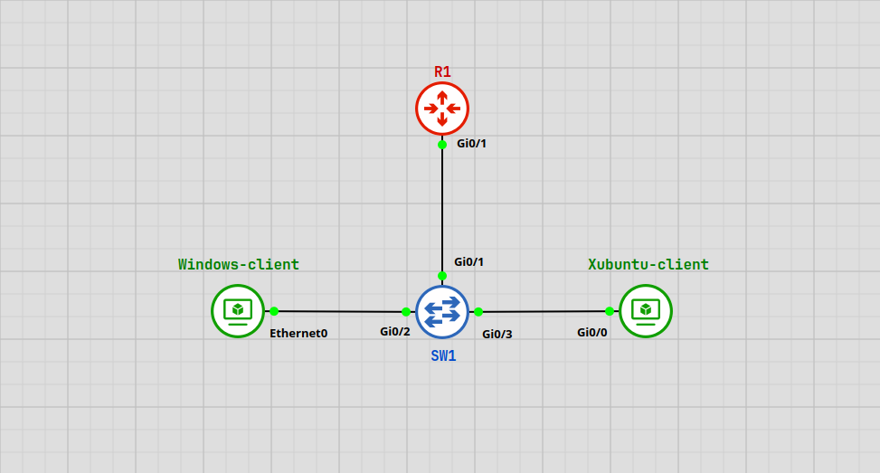
Ex 1:
Wireshark Protocol Monitoring
https://github.com/amelcharolinesgn2/ANJAR_CCNP_Lab
Practical protocol monitoring in a small network using Wireshark. It combines four connected chapters: initial network setup, full packet observation, DHCP troubleshooting, and advanced protocol filtering. Together, they form a complete workflow that shows how packets appear, how services respond, and how each protocol behaves during normal and failed communication.
The objectives are:
Set up the LAN with DHCP, DNS, and HTTP services on the router.
Observe packets in real time without filters to see how protocols communicate.
Troubleshoot DHCP failure on Xubuntu caused by switch misconfiguration.
Apply protocol-specific filters to analyse ARP, DNS, ICMP, UDP, TCP, and HTTP.
Save captures for documentation and later analysis.

Slide 4
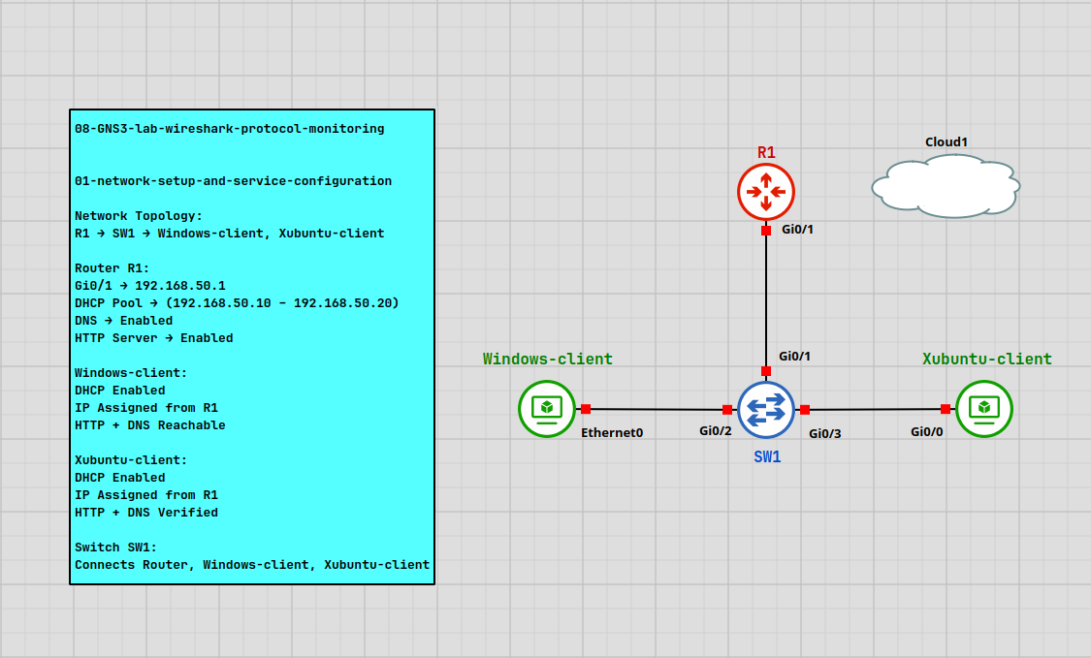
Wireshark Protocol Monitoring (Con’t)
1. Network Setup and Service Configuration
1.1. Topology
Setup of a small LAN used for packet monitoring. The router is given its initial IP configuration and is prepared to provide DHCP, DNS, and HTTP services. Both clients are set to DHCP mode so they receive their network settings from the router. Xubuntu is prepared with a simple installation of Wireshark.
Device | Interface | Connected to -> | Peer Interface | IP Address | Subnet Mask | Gateway
R1 (Router) | Gi0/1 | SW1 | Gi0/1 (SW1) | 192.168.50.1 | 255.255.255.0 | N/A
Windows-Client | Ethernet0 | SW1 | Gi0/2 (SW1) | DHCP (192.168.50.10–192.168.50.20) | 255.255.255.0 | 192.168.50.1
Xubuntu-Client | Gi0/0 | SW1 | Gi0/3 (SW1) | DHCP (192.168.50.10–192.168.50.20) | 255.255.255.0 | 192.168.50.1
1.2. Step
Configure the router interface to enable basic Layer 3 connectivity in the LAN.
Activate the router services required for DHCP, HTTP, and DNS operation.
Set both clients to automatic network configuration mode.
Verify that the clients receive their settings from the router.
Install Wireshark on Xubuntu and confirm that the interface is available for capture.
Test basic client connectivity to generate initial ARP and ICMP traffic.

Slide 5
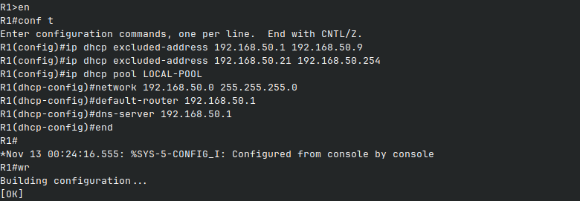
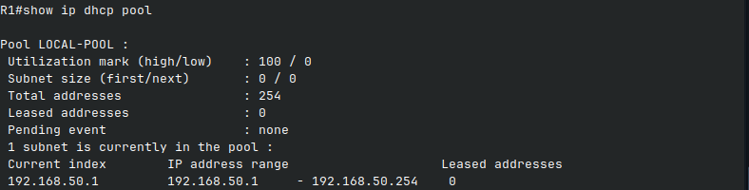
Wireshark Protocol Monitoring (Con’t)
1.3. Router Services - DHCP Configuration
Configures DHCP service on R1 so both clients automatically receive their IP settings. The router assigns addresses from the LAN subnet and provides the default gateway and DNS information.
Router (R1) - DHCP Configuration
IP configuration for DHCP uses a single excluded address for the router itself. The DHCP pool LOCAL-POOL assigns dynamic addresses to all LAN clients.
R1#show ip dhcp pool
enable
configure terminal
ip dhcp excluded-address 192.168.50.1 192.168.50.9
ip dhcp excluded-address 192.168.50.21 192.168.50.254
ip dhcp pool LOCAL-POOL
network 192.168.50.0 255.255.255.0
default-router 192.168.50.1
dns-server 192.168.50.1
end
write memory

Slide 6
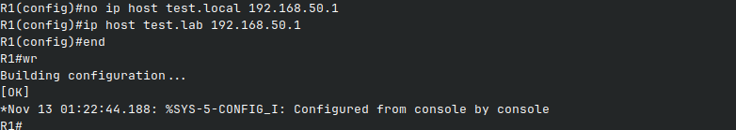
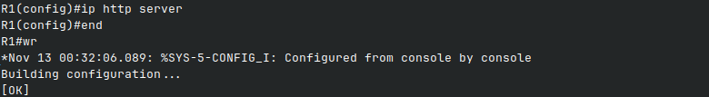
Wireshark Protocol Monitoring (Con’t)
1.4. Router Services - HTTP Configuration
1.5. Router Services - DNS Configuration
This step enables the HTTP service on R1 so clients in the LAN can generate web traffic for packet monitoring. The service provides a simple test page that allows Wireshark to capture HTTP requests and responses.
This step configures a simple DNS service on R1 so that clients can generate DNS queries for packet analysis. The router provides a basic hostname-to-IP mapping used for testing in Wireshark.
R1 - DNS Service Setup
Router (R1) - HTTP Service Activation
DNS service is enabled globally, and a test hostname is mapped to the router’s LAN IP address.
HTTP service is enabled globally on the router to allow basic web access
enable
configure terminal
ip dns server
ip host test.lab 192.168.50.1
end
write memory
enable
configure terminal
ip http server
end
write memory

Slide 7
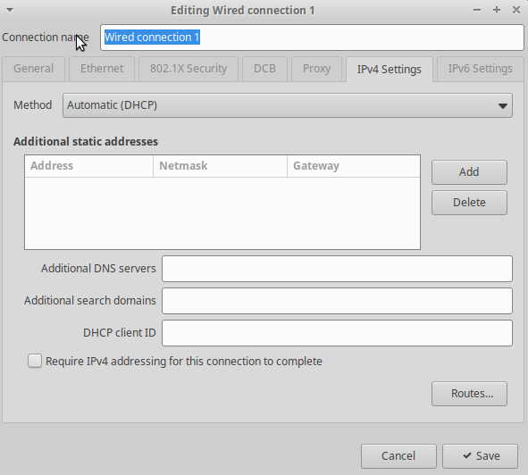
Wireshark Protocol Monitoring (Con’t)
1.6. Xubuntu DHCP, HTTP and DNS Verification
This section verifies that the Xubuntu client successfully receives an IP address from the DHCP pool on R1. The network adapter must be configured to use automatic DHCP so the client can request and obtain its settings dynamically.
Xubuntu – DHCP Configuration
The network connection is set to automatic mode so the client uses DHCP.
method automatic DHCP

Slide 8
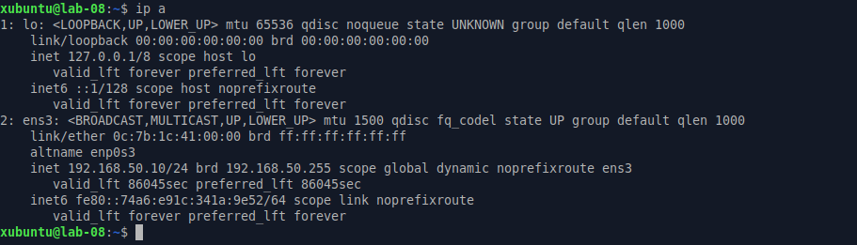
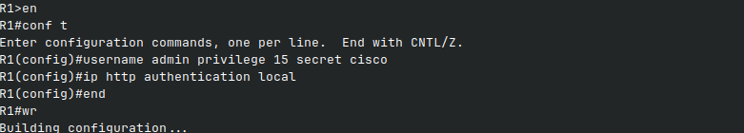
Wireshark Protocol Monitoring (Con’t)
Xubuntu – Assigned IP Address
Xubuntu –HTTP Verification
The terminal output shows the dynamic IPv4 address provided by the router.
This section verifies that the Xubuntu client can reach the HTTP service running on R1.
ip a
R1 – HTTP Authentication Setup
A local user account is created on R1 to allow browser access when HTTP authentication is required.
conf t
username admin privilege 15 secret cisco
ip http authentication local
end
write memory

Slide 9
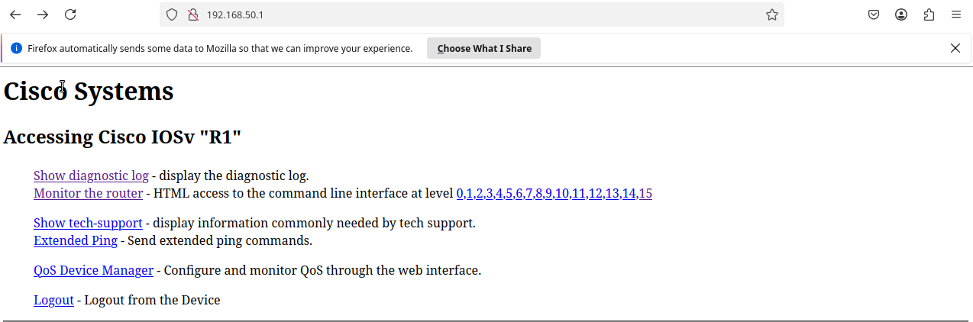
Wireshark Protocol Monitoring (Con’t)
Xubuntu – Accessing the Router HTTP Page
The browser is directed to the router's LAN address to test HTTP connectivity.
http://192.168.50.1

Slide 10

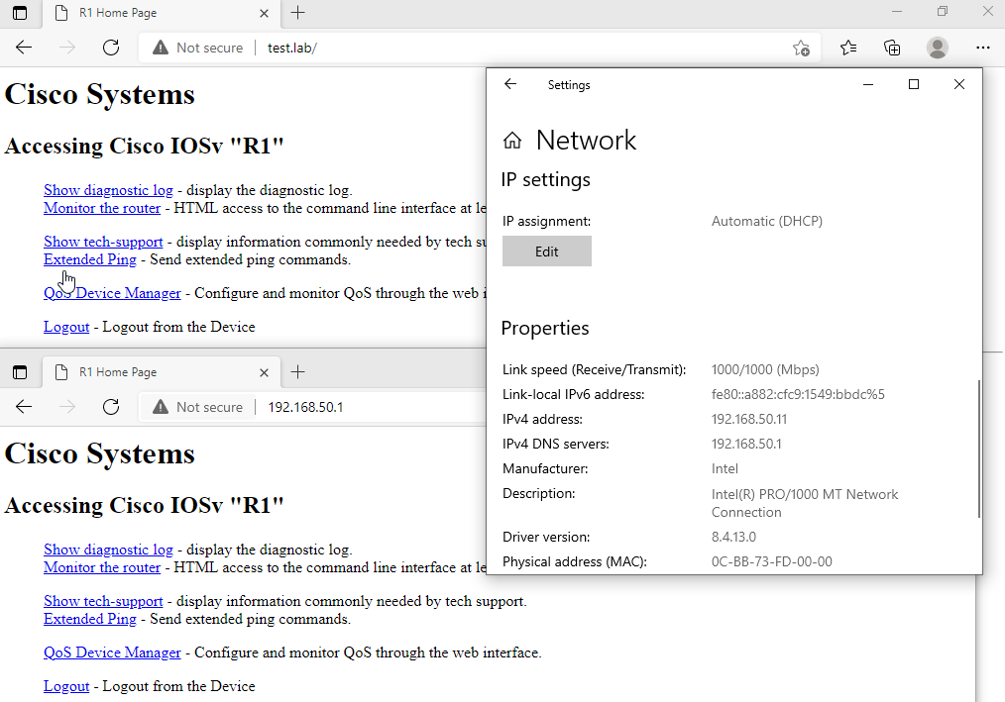
Wireshark Protocol Monitoring (Con’t)
1.7. Windows Client DNS Verification*
1.8. Xubuntu Client – Wireshark Installation
The Windows client confirms DHCP functionality by successfully receiving an IP address from the router. In this lab, the client is assigned 192.168.50.11, indicating that the DHCP pool on R1 is operating correctly. The client also loads the router’s web interface both through its IP address and through the DNS hostname test.lab, confirming proper operation of both HTTP and DNS services in the network.
Wireshark is installed on the Xubuntu client to capture and analyze network traffic generated in the lab. The client uses the default package manager to install the application, ensuring it is ready for packet monitoring.
http://192.168.50.1
httpsudo apt update
sudo apt install wireshark -y
http://192.168.50.1
http://test.lab

Slide 11
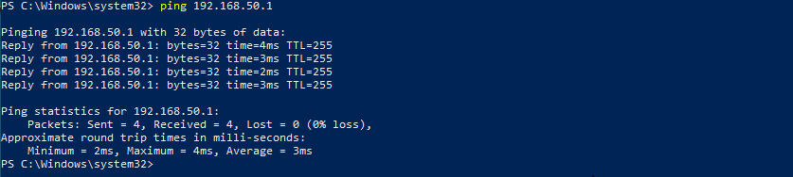
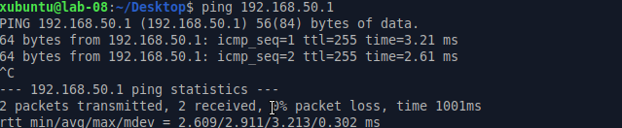
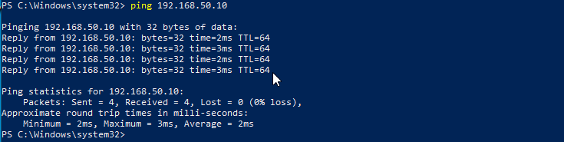
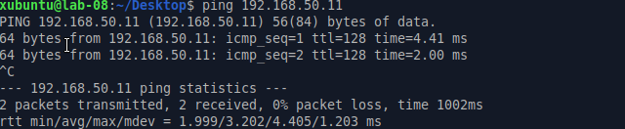
Wireshark Protocol Monitoring (Con’t)
1.9. Full Connectivity Verification – Router, Xubuntu and Windows
From Windows → Router (R1)
This step verifies clear end-to-end connectivity across the lab. Each device sends ICMP echo requests to the others to confirm that ARP and ICMP traffic are functioning before packet capture.
ping 192.168.50.1
From Xubuntu → Router (R1)
ping 192.168.50.1
From Windows → Xubuntu
ping 192.168.50.10
From Xubuntu → Windows
ping 192.168.50.11

Slide 12
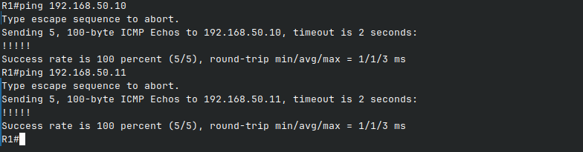
Wireshark Protocol Monitoring (Con’t)
From Router (R1) → Both Clients
ping 192.168.50.10
ping 192.168.50.11

Slide 13
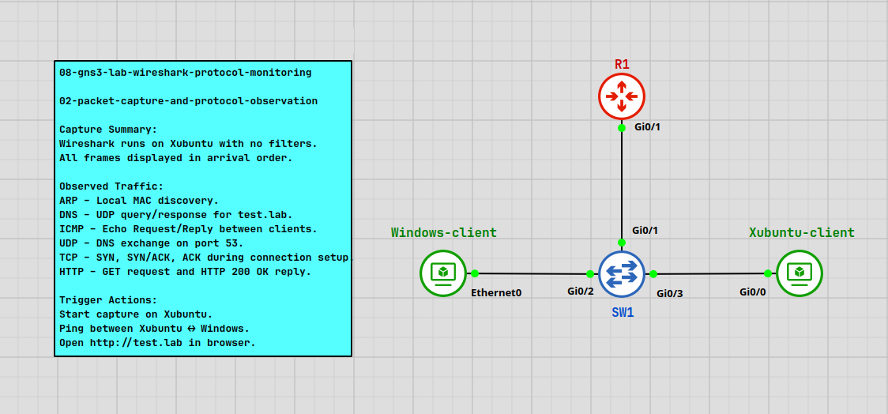
Wireshark Protocol Monitoring (Con’t)
2. Packet Capture and Protocol Observation
Wireshark captures every packet that moves across the interface and shows it in real time. Each line represents one packet with the time it appears, the source, the destination, the protocol, and simple information about what the packet does. In this chapter, the capture runs without filters, so the user can see natural traffic such as ARP, DNS, ICMP, UDP, TCP, and HTTP. Basic actions like pinging between clients, pinging the router, or opening the test.lab page generate packets, and Wireshark displays them in the order they arrive. This introduction helps the user understand how common protocols appear during normal communication and how the network behaves when devices send or receive data.

Slide 14
Wireshark Protocol Monitoring (Con’t)
2.1. Protocol
2.2. Addressing Table
Protocol | Full Name | Meaning / Simple Explanation
ARP | Address Resolution Protocol | Maps an IP address to a MAC address so devices can communicate inside the LAN.
DNS | Domain Name System | Translates domain names (e.g., test.lab) into IP addresses.
ICMP | Internet Control Message Protocol | Used for connectivity testing (ping), error messages, and basic diagnostics.
UDP | User Datagram Protocol | Fast, lightweight transport without acknowledgments. Used by DNS and similar services.
TCP | Transmission Control Protocol | Reliable transport with handshake, acknowledgments, and ordered delivery.
HTTP | Hypertext Transfer Protocol | Web protocol for client–server communication (GET requests and responses).
Device | IP Address
Xubuntu-client | 192.168.50.10
Windows-client | 192.168.50.11
Router (R1) | 192.168.50.1

Slide 15
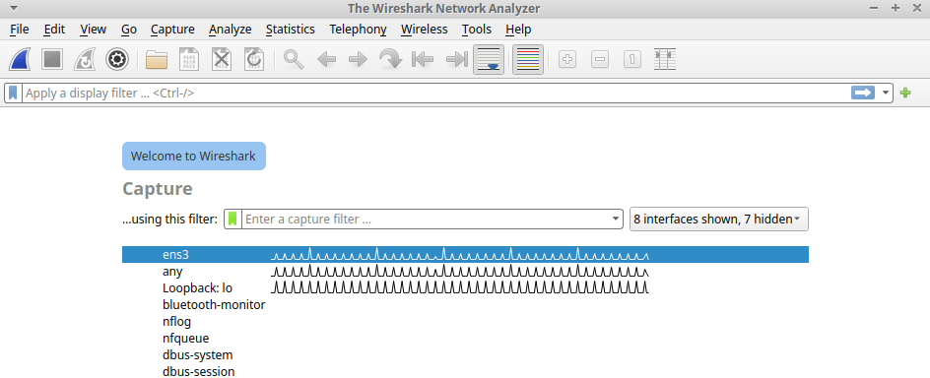

Wireshark Protocol Monitoring (Con’t)
2.3. Step
Start packet capture on the Xubuntu interface without filters.
See how ARP packets appear when devices communicate on the local network.
See how DNS packets appear when a domain name is requested.
See how ICMP packets appear when a device is reached with ping.
See how UDP packets appear appear when a webpage is opened.
See how TCP and HTTP packets appear when a webpage is opened.
After starting Wireshark, a list of available network interfaces appears. Each interface represents a network path that the system can capture from. In this environment, the active interface is named ens3, and it is used to monitor all traffic coming from and going to the virtual machine.
ens3
2.4. Full Packet View
Wireshark shows all captured packets in the main list at the top. Each line represents one packet with its time, source, destination, protocol, and basic information. The lower left panel displays the structured details of the selected packet, such as Ethernet, IP, or TCP fields. The lower right panel shows the raw packet data in hexadecimal and ASCII form. Together, these views provide a complete picture of how the packet looks on every layer.
Notes:
Loopback (lo) – internal interface used by the system to communicate with itself.
It does not send or receive any real network traffic, so Wireshark shows only local system packets.
Any – virtual interface that merges all other interfaces into one view.
It mixes multiple traffic sources together and produces noise, so it is not used for controlled packet capture.
wireshark

Slide 16
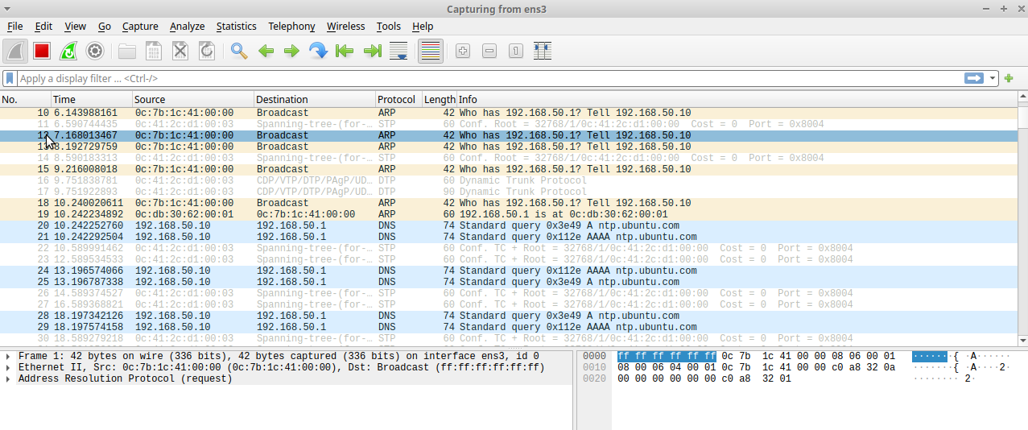
Wireshark Protocol Monitoring (Con’t)
Main list
The main list displays all captured packets in real time.

Slide 17
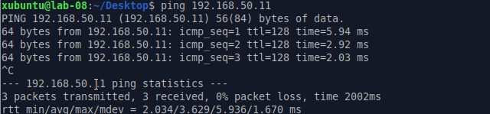
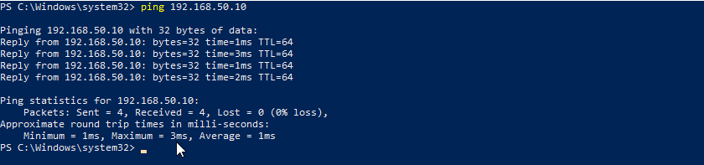
Wireshark Protocol Monitoring (Con’t)
2.5. ARP Capture
Ping Xubuntu to Windows
ARP identifies the MAC address of a device inside the local network when the IP address is known. ARP packets appear only when a device does not have the required MAC address stored in its ARP cache. After the cache is filled, repeated pings no longer create new ARP requests until the cache expires.
ping 192.168.50.11
ARP Type | Description
ARP Request | "Who has ?" — a device asks who owns an IP address.
ARP Reply | " is at " — the target device responds with its MAC.
Ping Windows to Xubuntu
ping 192.168.50.10

Slide 18
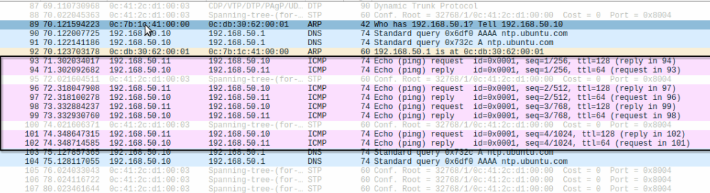
Wireshark Protocol Monitoring (Con’t)
ICMP Traffic
**ICMP Traffic
Ping packets between Xubuntu and Windows are visible here. These ICMP exchanges confirm that both devices communicate correctly. The initial ping also triggered ARP requests and replies, which allowed the devices to learn each other's MAC addresses before the ICMP traffic could flow.

Slide 19
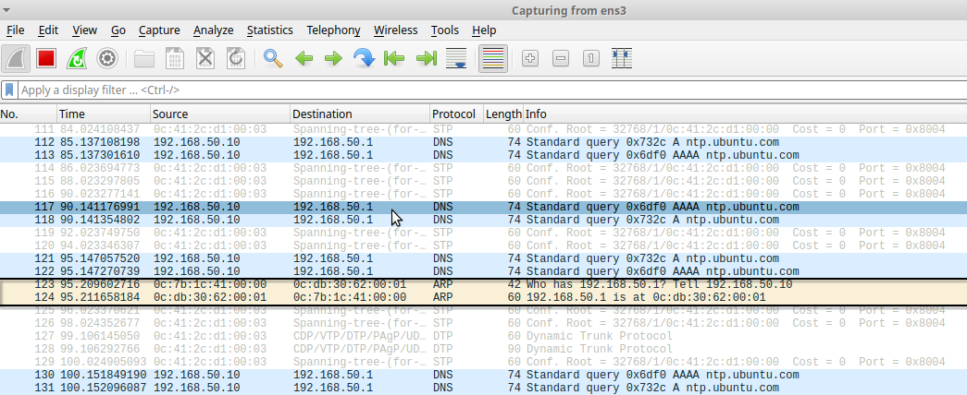
Wireshark Protocol Monitoring (Con’t)
ARP Response
ARP replies appear immediately after the request. They confirm the MAC address of the destination device and allow the communication to continue across the local network. You will see the request and reply sequence on the main packet list when the ping begins.
Notes.: ARP does not depend on ping. It appears automatically whenever a device needs the MAC address of another device. Ping can trigger ARP if the MAC address is unknown, but ARP also appears during normal network activity such as DNS, DHCP, or opening web pages.

Slide 20
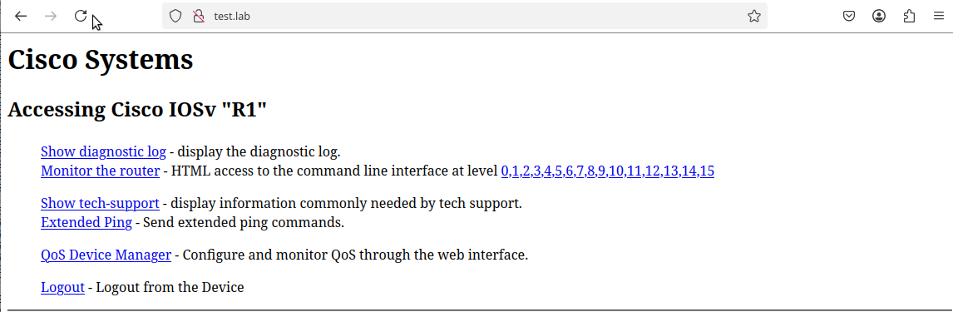
Wireshark Protocol Monitoring (Con’t)
2.5 DNS Capture (Xubuntu)
Triggering DNS from Xubuntu
This section explains how DNS traffic is captured when a webpage is opened from the Xubuntu browser. DNS converts a hostname into an IP address, and Wireshark allows you to see both the query and the response directly.
Open browser and navigate to: http://test.lab
DNS Phase | Description
DNS Query | Xubuntu asks for the IP address of the domain name.
DNS Response | The router returns the resolved IP address.

Slide 21
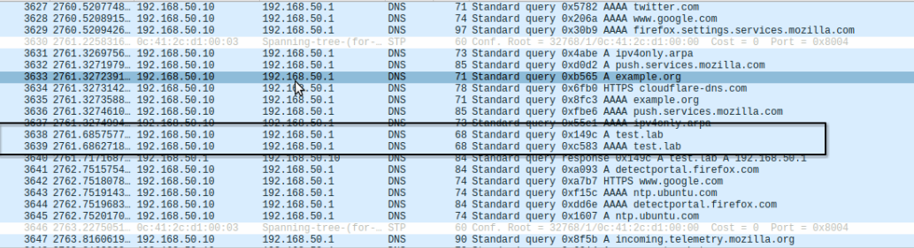
Wireshark Protocol Monitoring (Con’t)
DNS Frames in Wireshark
After opening the test.lab page, DNS packets immediately appear in the capture. You will see a query for the domain name and a matching response. Add your screenshot below.
Notes.: Xubuntu generates the DNS request as soon as the hostname is used in the browser.
The router acts as the DNS responder. DNS packets are easy to identify in the Protocol column (DNS).
Notes:
https://github.com/lukasdula/lab-08-GNS3-wireshark-protocol-monitoring/blob/main/02-packet-capture-and-protocol-observation.md

Slide 22
Wireshark Protocol Monitoring (Con’t)
1.7. Windows Client DNS Verification*
http://192.168.50.1
http://test.lab

Slide 23
Wireshark Protocol Monitoring (Con’t)
1.7. Windows Client DNS Verification*
http://192.168.50.1
http://test.lab

Slide 24
Wireshark Protocol Monitoring (Con’t)
1.7. Windows Client DNS Verification*
http://192.168.50.1
http://test.lab

Slide 25
Wireshark Protocol Monitoring (Con’t)
1.7. Windows Client DNS Verification*
http://192.168.50.1
http://test.lab

Slide 26
Wireshark Protocol Monitoring (Con’t)
1.7. Windows Client DNS Verification*
http://192.168.50.1
http://test.lab

Slide 27
Wireshark Protocol Monitoring (Con’t)
1.7. Windows Client DNS Verification*
http://192.168.50.1
http://test.lab

Slide 28
Wireshark Protocol Monitoring (Con’t)
1.7. Windows Client DNS Verification*
http://192.168.50.1
http://test.lab

Slide 29
Wireshark Protocol Monitoring (Con’t)
1.7. Windows Client DNS Verification*
http://192.168.50.1
http://test.lab

Slide 30
Wireshark Protocol Monitoring (Con’t)
1.7. Windows Client DNS Verification*
http://192.168.50.1
http://test.lab

Slide 31
Wireshark Protocol Monitoring (Con’t)
1.7. Windows Client DNS Verification*
http://192.168.50.1
http://test.lab

Slide 32
Wireshark Protocol Monitoring (Con’t)
1.7. Windows Client DNS Verification*
http://192.168.50.1
http://test.lab

Slide 33
Wireshark Protocol Monitoring (Con’t)
1.7. Windows Client DNS Verification*
http://192.168.50.1
http://test.lab

Slide 34
Wireshark Protocol Monitoring (Con’t)
1.7. Windows Client DNS Verification*
http://192.168.50.1
http://test.lab

Slide 35
Wireshark Protocol Monitoring (Con’t)
1.7. Windows Client DNS Verification*
http://192.168.50.1
http://test.lab

Slide 36
MPLS BGP VPN
Multi-Protocol Label Switching
Notes:
Lab #2 Two LANs connected by a router
http://wpage.unina.it/rcanonic/didattica/gns3-labs/lab2/
Lab #16 MPLS with static Label Switched Path (LSP)
http://wpage.unina.it/rcanonic/didattica/gns3-labs/lab16/
https://www.quisted.net/index.php/2018/04/30/lab-viii-mpls-mp-bgp-eompls/
https://blog.pierky.com/gns3-lab-bgp-multihoming-to-a-single-provider-with-partial-routing/

Slide 37
MPLS BGP VPN
Multi-Protocol Label Switching
Notes:
Lab #2 Two LANs connected by a router
http://wpage.unina.it/rcanonic/didattica/gns3-labs/lab2/
Lab #16 MPLS with static Label Switched Path (LSP)
http://wpage.unina.it/rcanonic/didattica/gns3-labs/lab16/
https://www.quisted.net/index.php/2018/04/30/lab-viii-mpls-mp-bgp-eompls/
https://blog.pierky.com/gns3-lab-bgp-multihoming-to-a-single-provider-with-partial-routing/

Slide 38
MPLS BGP VPN
Multi-Protocol Label Switching
Notes:
Lab #2 Two LANs connected by a router
http://wpage.unina.it/rcanonic/didattica/gns3-labs/lab2/
Lab #16 MPLS with static Label Switched Path (LSP)
http://wpage.unina.it/rcanonic/didattica/gns3-labs/lab16/
https://www.quisted.net/index.php/2018/04/30/lab-viii-mpls-mp-bgp-eompls/
https://blog.pierky.com/gns3-lab-bgp-multihoming-to-a-single-provider-with-partial-routing/

Slide 39

MPLS with static Label Switched Path (LSP)
Multiprotocol Label Switching (MPLS) is a routing technique that allows moving data from one node to the next based on external labels rather than destination IP addresses. Packets are routed along pre-established Label Switched Paths (LSPs).
Label Switch Routers (LSR), located in the inner part of an MPLS network, forward packets based on MPLS labels.
Label Edge Routers (LER), located at the edge of an MPLS network, encapsulate IP packets by adding the MPLS header (push operation) to traffic coming from adjacent routers external to the MPLS network and decapsulate IP packets by removing the MPLS header (pop operation) from traffic coming from adjacent MPLS routers.
In MPLS, packets can carry multiple labels in a stack. An LSR can swap the label at the top of the stack, pop the stack, or swap the label and push one or more labels into the stack. The processing of a packet is always based on the top label.
As described in RFC 3032, MPLS Label Stack Encoding, the label stack is represented as a sequence of label stack entries. Each label stack entry consists of 4 octets comprising a 20-bits label field. Hence, the maximum label value is 1048575. The S bit, if 1, marks the last entry of the label stack (Bottom of Stack). create a static LSP in an MPLS network consisting of two LERs and a single LSR. Packets towards host H5 are labeled by LER R1 with label 100. The intermediate LSR R2 swaps label 100 into label 200 and forwards packets to the LER R3 which, in turn, pops the label and delivers the packets to the destination H5.
For packets generated by H5, the LER R3 encapsulates them with label 300. The intermediate LSR R2 swaps label 300 into label 400 and delivers the packets to the LER R1. Finally, R1 pops the MPLS label and delivers the packets to the destination H4
As described in RFC 3032, MPLS Label Stack Encoding, the label stack is represented as a sequence of label stack entries. Each label stack entry consists of 4 octets comprising a 20-bits label field. Hence, the maximum label value is 1048575. The S bit, if 1, marks the last entry of the label stack (Bottom of Stack). create a static LSP in an MPLS network consisting of two LERs and a single LSR. Packets towards host H5 are labeled by LER R1 with label 100. The intermediate LSR R2 swaps label 100 into label 200 and forwards packets to the LER R3 which, in turn, pops the label and delivers the packets to the destination H5.
For packets generated by H5, the LER R3 encapsulates them with label 300. The intermediate LSR R2 swaps label 300 into label 400 and delivers the packets to the LER R1. Finally, R1 pops the MPLS label and delivers the packets to the destination H4

Slide 40
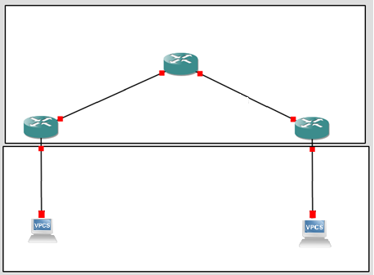
LSR
LSP: label 100
LSP: label 200
LSP: label 400
LSP: label 300
. 2
. 2
R2
10.0.1.0/30
LER
. 1
10.0.0.0/30
. 1
R1
R3
LER
. 1
. 1
192.168.1.0/24
192.168.2.0/24
e0
. 2
e0
. 2
H4
H5
Notes:
http://wpage.unina.it/rcanonic/didattica/gns3-labs/lab2/

Slide 41
BGP Message
Border Gateway protocol (BGP
BGP MPLS Layer 3 VPNs GNS3 Lab
MPLS L3 VPN
Cisco MPLS VPN Configuration Guide
Notes:
https://www.slideserve.com/hatten/lecture-7-l2-mpls-vpn-vpws-h-vpls-powerpoint-ppt-presentation

Slide 42
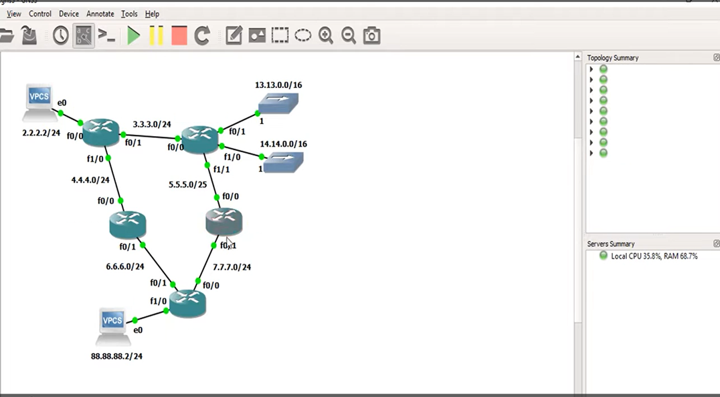
Cisco.net
SGB-600
BLG-700
AMA-AS200
13.13.0.0/16
14.14.0.0/16
Cisco.net
L3-AS_100
ISP-901
L3-AS_100
AMA-AS200
SBG-600
BLG-700
myVPCS.com
ISP-901

Slide 43
MPLS
(Multiprotocol Label Switching)
MPLS with static Label Switched Path (LSP)
http://wpage.unina.it/rcanonic/didattica/gns3-labs/lab16/
Notes:
http://wpage.unina.it/rcanonic/didattica/gns3-labs/lab16/

Slide 44
Konfigurasi autonomous system (AS), pembentukan neighbor (tetangga) EBGP/IBGP, dan advertising network
Pertukaran rute antar-jaringan berbeda, manipulasi jalur menggunakan atribut, dan verifikasi sesi

Slide 45
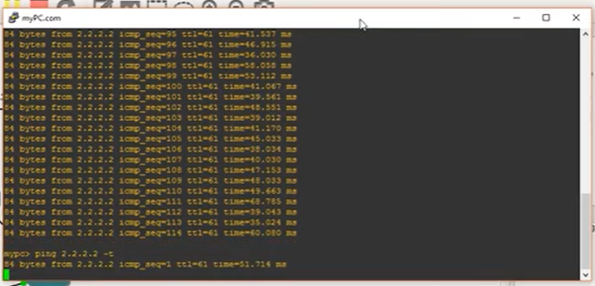
IP addres telah di configure BGP

Slide 46
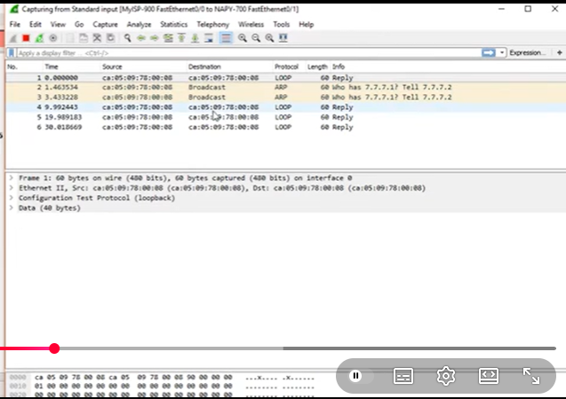
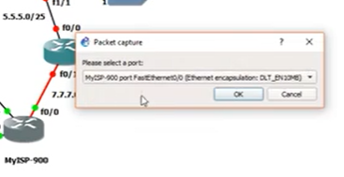
Run Wiresark
Kita adalah Admin dari My ISP
Kita adalah Admin dari My ISP
Start Capture

Slide 47
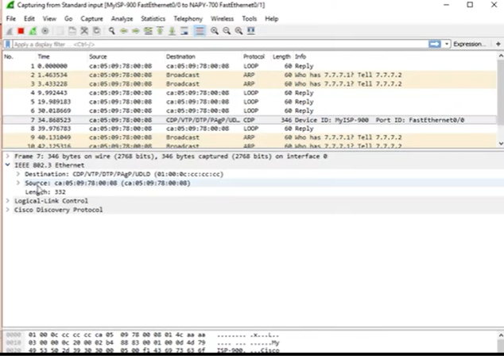
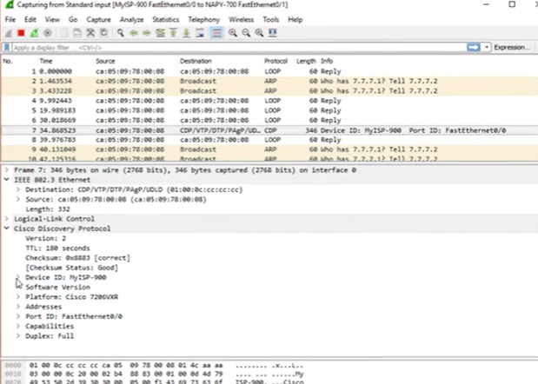
CDP

Slide 48
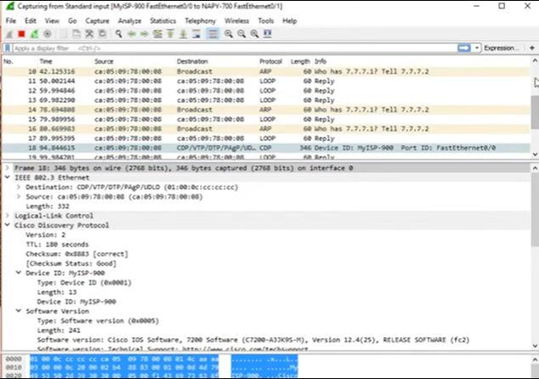
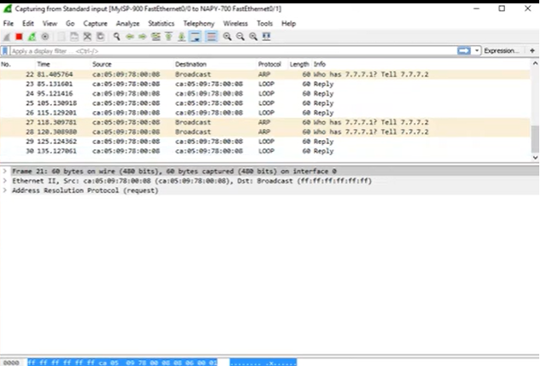
Int 0/0 no cdp
CDP ke cdp berikutnya : s3etiap 1 menit
Send mac address 7.7.7.1 tidak ketahuan

Slide 49
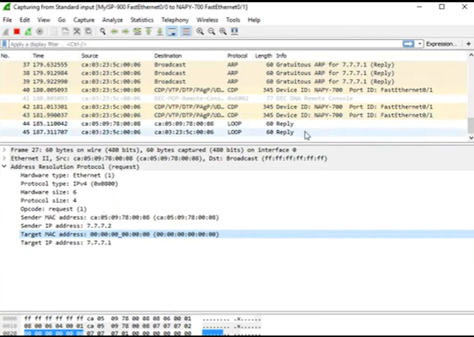
NAPY telah hidup
NAPY telah hidup

Slide 50
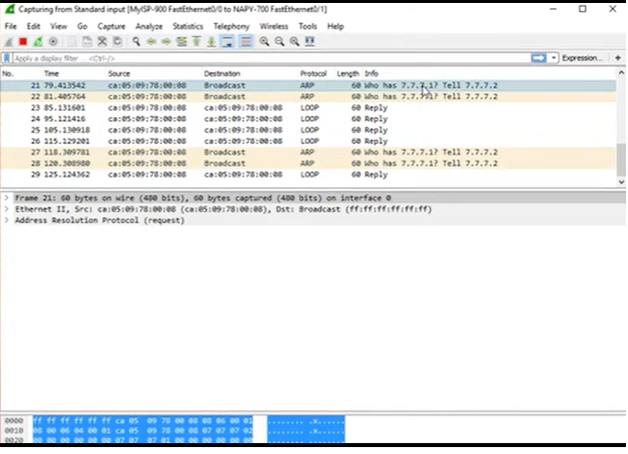
CDP
No CDP
Yang Tampil Packet ARP

Slide 51
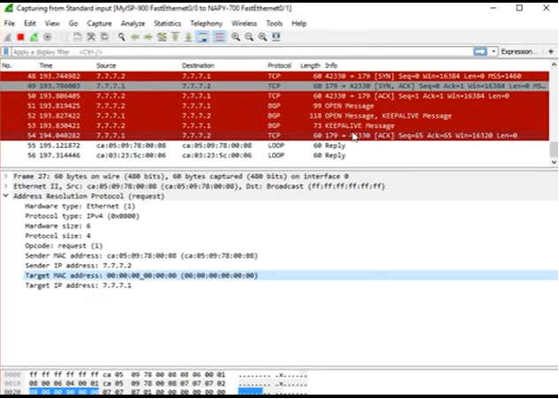
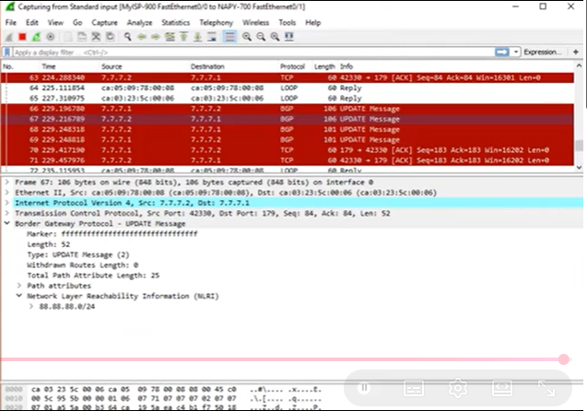
Aktifkan Router MKPY
771 send to 772

Slide 52
Gateway
Notes:
https://www.quisted.net/index.php/2018/04/30/lab-viii-mpls-mp-bgp-eompls/

